Slide 1
Ticket Analysis with Markov Chain
How a Markov Chain can be used to analyze service tickets and generate data
11-14-2018
Don Bacon

Slide 2
In This Exciting Hour we will cover…
What problems are we trying to solve?
What is a Markov Chain?
Some applications
Examples
How Markov Chain can be used to analyze service tickets
The Collector-Producer Pattern
Using Markov chain structure to analyze and produce all kinds of data
Live demos
And more!

Slide 3

But First…
A story
Fun Fact: A good story is Authentic, is Creative, makes an Emotional and Personal connection, takes the Audience on a Journey.

Slide 4

I was curious
About brand drug names
Xarelto
Where do they come from?
Pradaxa
Any patterns to the names?
Xifaxan
Tremfya
Could I make software that could discover these patterns to create my own drug names?
Xeljanz
What else could I apply this to?

Slide 5

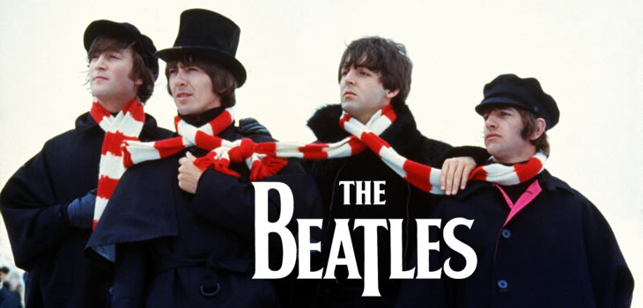
Which got me
about
What makes their music so special?
Any patterns to the chord progressions?
Could I make software that could discover these patterns to create my own “Beatles-esque” music?

Slide 6

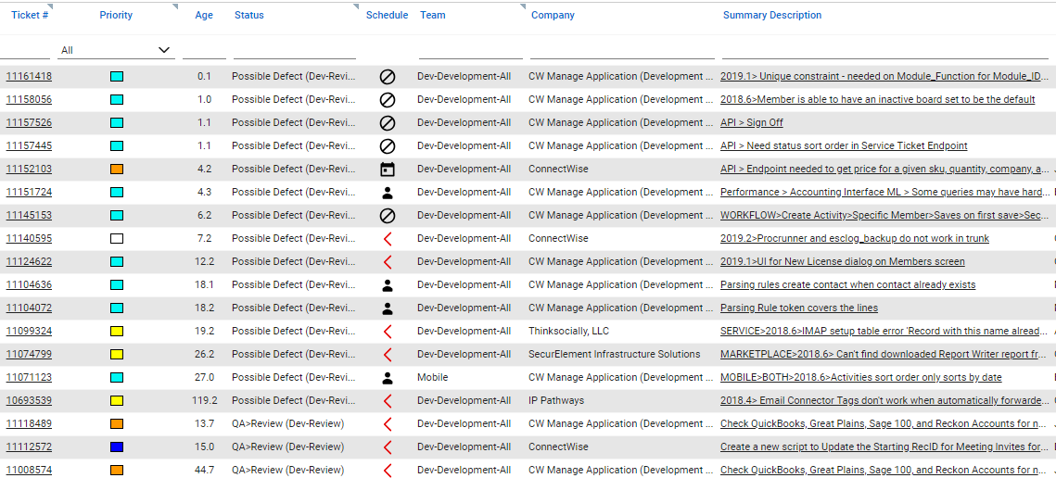
Then I Joined
Looking at Service Boards got me to wondering…
What are the big problem areas?
What are the categories to focus on?
Could I make software that could pull that out of service tickets?

Slide 7
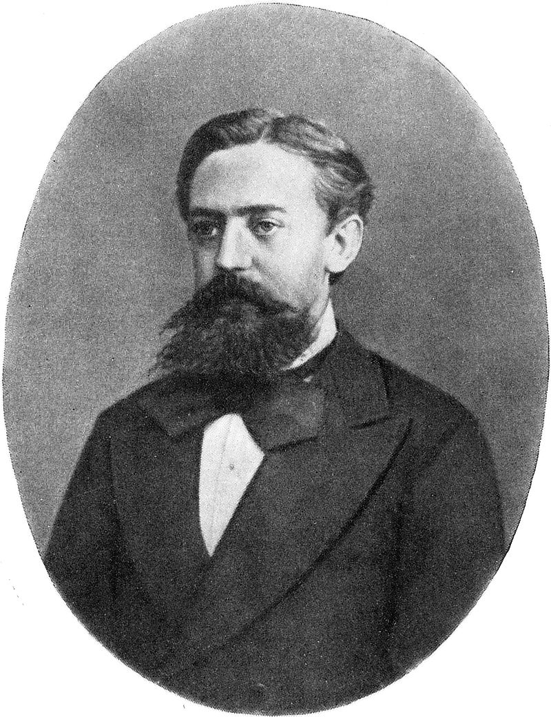
What do the problems around drug names, The Beatles and service tickets and all have in common?
Markov Chain
Andrey Andreyevich Markov (1856 – 1922)

Slide 8
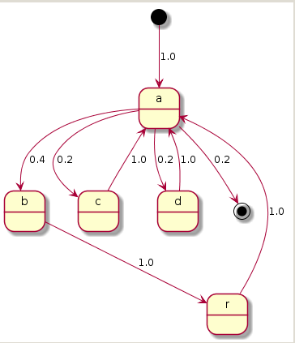
So What is a Markov Chain?
A structure describing a sequence of possible events in which the probability of each event depends only on the state attained in the previous event.
Simple text example: “abracadabra”
Not very interesting

Slide 9
For you Math types, a formal definition
A discrete-time Markov chain is a sequence of random variables X1, X2, X3, … with the Markov property: the probability of moving to the next state depends only on the present state.
A Markov chain with memory (Markov chain of order m) is a process where the future state depends on the past m states.
We are interested in absorbing Markov chains with memory

Slide 10
Some Applications
Text analysis
Unstructured text as in prose
Structured text in JSON format
Service Tickets
Tweets
Speech recognition (hidden Markov models)
Markov modelling of the English language
Google’s page rank of a webpage is defined by a Markov chain
Algorithmic music composition (more on that later!)

Slide 11
Order 1 Markov Chain State Transition Diagram
Service Tickets (sample)
0.02857
import
0.15385
0.15385
0.06098
0.64634
0.02439
0.02439
tool
utility
spreadsheet
0.07143
0.11429
0.08571
product
map
add
0.15385
0.15385
configuration
0.04286
0.02857
adjustment
occurrence
enhancement
issue

Slide 12
Markov Chain with Memory
Number of remembered states is the Order of the Markov Chain.
To use the Import example (click the mouse!)

Slide 13
Order 2 Markov Chain State Transition Diagram
0.03774
5 other
22.64%
import tool
35.85%
0.01887
19 other
15.1%
11.3%
9.4%
5.6%
3.7%
configuration
map
add
issue
ui

Slide 14
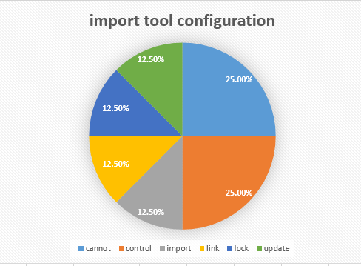
Markov Chain order 3 “import tool configuration”
{ "import tool configuration" : {
"totalOccurrence" : 8,
"cannot": {
"occurrence" : 2, "probability" : 0.25
},
"control": {
"occurrence" : 2, "probability" : 0.25
},
"import": {
"occurrence" : 1, "probability" : 0.125
},
"link": {
"occurrence" : 1, "probability" : 0.125
},
"lock": {
"occurrence" : 1, "probability" : 0.125
},
"update": {
"occurrence" : 1, "probability" : 0.125
}
} }

Slide 15
Collector – Producer Pattern
Collector – Creates an order-n Markov Chain from source Data
Producer – Creates data based on Markov chain probabilities
Raw Data
Collector
Markov chain
Producer
Simulated Data
Dolibroxa
Dulacia
Edigoxa
Furanexa
Glynpati

Slide 16
Collector – Producer Examples
Collector | Markov Chain | Producer | Output
CharacterCollector | MarkovChain<Character, Word> | WordProducer | Set<Word>
WordCollector | MarkovChain<Word, Sentence> | SentenceProducer | Set<Sentence>
HarmonyChordCollector | MarkovChain<HarmonyChord, ChordProgression | ChordProgressionProducer | ChordProgressionScrapbook
Collect
From
To Produce
Characters
Sentence
Words
Words
Book
Sentences
HarmonyChords
Song
ChordProgressions

Slide 17
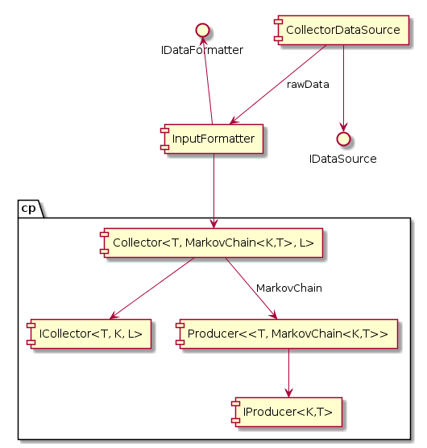
Collector/Producer Components
Collector

Slide 18
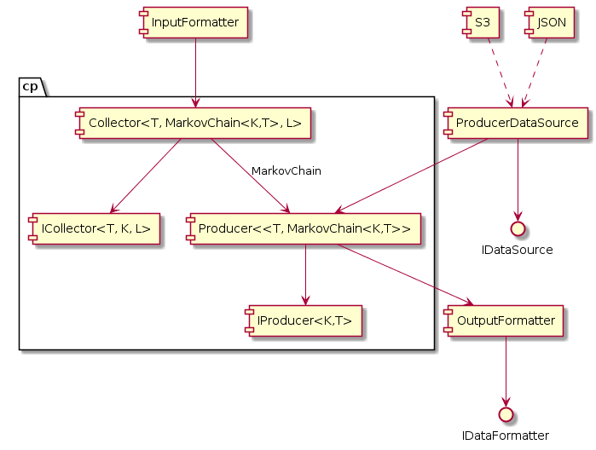
Collector/Producer Components
Producer

Slide 19
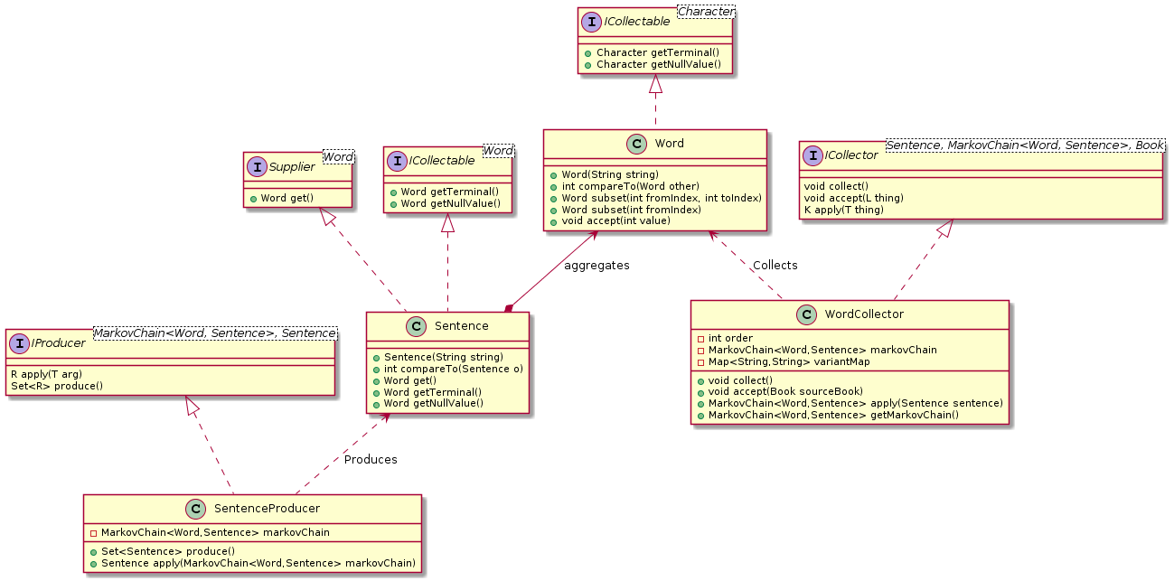
If you’re a fan of Class Diagrams…

Slide 20
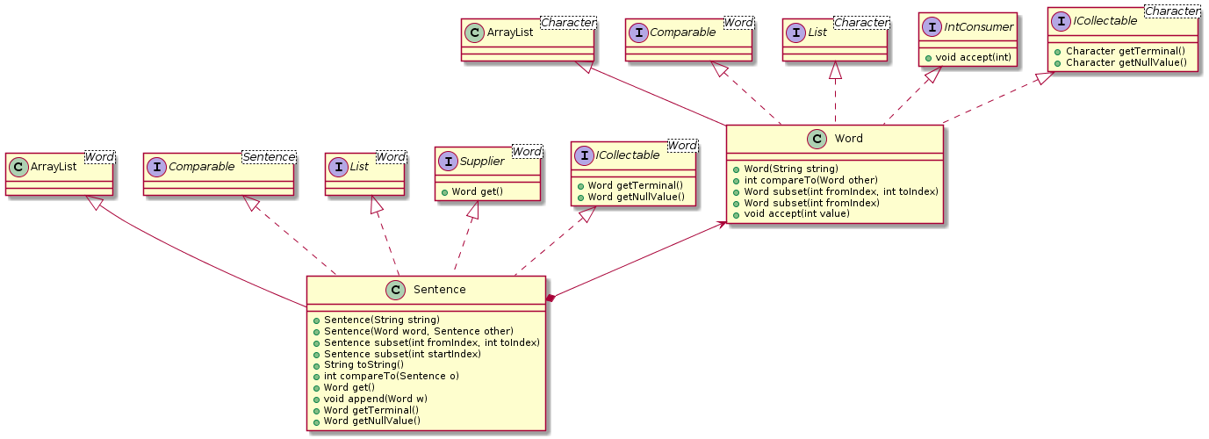
Word - Sentence

Slide 21
Live Demo
WordProducer
test sample data
drug names – order 3
WordCollector
tickets_out.json – 666 records
tickets_sample.json – small sample of 68 records
tickets_out Dev-Review.json – 1000 records
tickets_small_sample.json – order 2, csv output
HarmonyChordCollector
Beatles – order 2
ChordProgressionProducer
Beatles – order 3

Slide 22
Opportunities for improvement
Collection Data Preparation
Collector results presentation
Results interpretation
Framework flexibility

Slide 23
Questions?
References
Markov chain Wikipedia Article
GitHub Projects
Math-lib
Music-framework
Text-processing

Slide 24


Slide 25
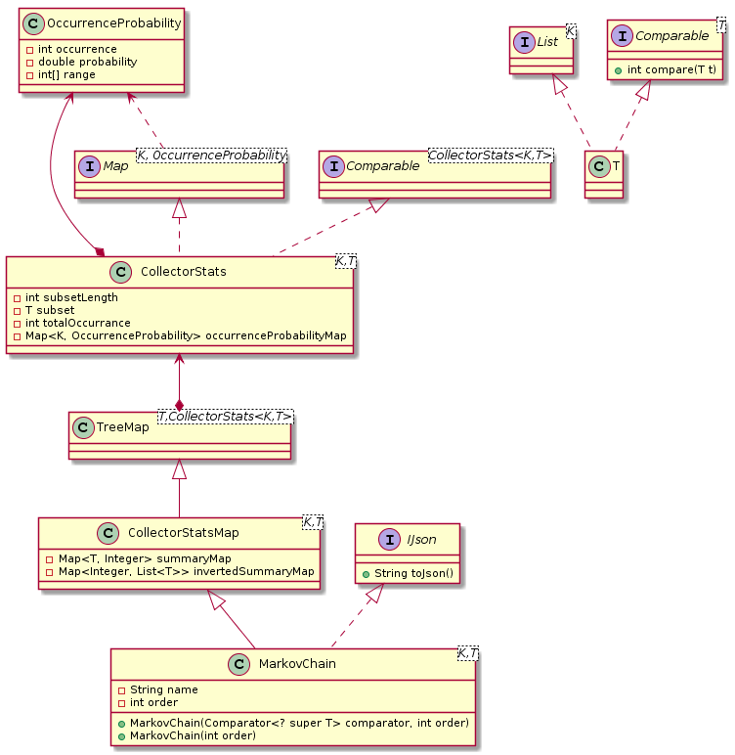
Extras

